Slide 1
BOOSTING SOFTWARE QUALITY: UNLEASHING THE POWER OF ENSEMBLE LEARNING FOR DEFECT DETECTION
Under the Guidance of
Ms.Faiza Iram
Department of Computer Science and Engineering

Slide 2
TEAM MEMBERS
2003A51237 - BEERAM ABHISATHVIKA REDDY
2003A51019 - FINZA TAZEEN
2103A51L03 - ARRABELLI JONA KARTHIK
2003A51277 - ARELLI KUSUMA SRI
2003A51283 - BOMMARABOINA VENKATESH

Slide 3
PROBLEM STATEMENT
Software defects can significantly impact the quality, reliability, and overall performance of software systems, leading to increased maintenance costs and potential disruptions in operations. Traditional defect prediction approaches often rely on single-model predictive techniques, which may lack the robustness and accuracy required to effectively identify and mitigate defects in complex software environments. Therefore, there is a pressing need to enhance software defect prediction methodologies by leveraging ensemble learning techniques.
Ensemble learning involves combining multiple predictive models to improve predictive accuracy, generalization, and robustness. However, the application of ensemble learning in software defect prediction remains underexplored. The problem statement is to investigate how ensemble learning methods, such as bagging, boosting, and stacking, can be effectively utilized to enhance software defect prediction accuracy and reliability.

Slide 4
OBJECTIVES
The objective of this study is to develop and evaluate ensemble learning-based software defect prediction models that address these challenges. By leveraging ensemble techniques, such as combining multiple classifiers or integrating diverse features, the aim is to improve the accuracy, robustness, and interpretability of defect prediction models. The research will involve experimentation with various ensemble learning algorithms and evaluation on real-world software datasets to assess the effectiveness and practical applicability of the proposed approach.

Slide 5
SOFTWARE DEFECT
A software defect, also known as a bug or an error, refers to a flaw or imperfection in a software application or system that causes it to behave unexpectedly or incorrectly. These defects can manifest in various forms, such as incorrect calculations, unexpected program termination (crashes), incorrect output, or functionality that does not meet the specified requirements.
Software defects can arise from various sources, including coding errors, design flaws, misunderstandings of requirements, or environmental factors. Detecting and fixing defects is crucial to ensure the reliability, functionality, and security of software systems. Software defect prediction aims to identify potential defects before they occur, allowing developers to address them proactively and improve overall software quality.

Slide 6
LITERATURE REVIEW
Title: "Deep Learning-Based Software Defect Prediction: A Comprehensive Review" - 2022
Description: This recent review provides an in-depth analysis of deep learning techniques for software defect prediction. It explores various deep learning architectures such as convolutional neural networks (CNNs), recurrent neural networks (RNNs), and transformer models. The review discusses their applicability, performance, and challenges in defect prediction tasks.
Algorithms Used: Convolutional Neural Networks (CNNs), Recurrent Neural Networks (RNNs), Transformer Models
Limitations: Limited empirical validation on the performance of deep learning models in defect prediction across diverse software development contexts. Challenges related to interpretability and model explainability in complex deep learning architectures.

Slide 7
Title: Overcoming Challenges in Software Defect Prediction Using Ensemble Learning: A Systematic Literature Review - 2021
Description: This systematic literature review identified common challenges in software defect prediction and explored how ensemble learning techniques can address these challenges. It synthesized findings from existing studies and provided insights into the current state-of-the-art in ensemble-based defect prediction.
Algorithms Used: Bagging, Boosting, Stacking
Limitations: Limited to a review of existing literature without empirical validation or case studies. Lack of discussion on emerging trends or future research directions in ensemble-based defect prediction.

Slide 8
Title: Ensemble Learning Approaches for Software Defect Prediction in Continuous Integration/Continuous Deployment (CI/CD) Pipelines - 2020
Description: This research focused on integrating ensemble learning approaches into CI/CD pipelines for continuous defect prediction. It proposed techniques for incorporating ensemble models into automated testing frameworks and evaluated their effectiveness in identifying defects early in the development cycle.
Algorithms Used: Bagging, Boosting, Stacking
Limitations: Limited discussion on the computational overhead and resource requirements of implementing ensemble learning in CI/CD pipelines. Lack of consideration for the scalability and efficiency of ensemble models in real-time defect prediction scenarios.

Slide 9
EXISTING METHODS
Manual Code Review:
Description: Human reviewers manually inspect source code to identify defects, inconsistencies, or areas for improvement.
Limitations:
Subjectivity: Reviewers may have differing interpretations of code quality and defects, leading to inconsistent results.
Time-Consuming: Manual code review can be labor-intensive and time-consuming, especially for large codebases.
Limited Coverage: It may not uncover subtle defects or those hidden in complex code paths.

Slide 10
Static Code Analysis:
Description: Automated tools analyze source code without executing it to identify potential defects such as syntax errors, code smells, or security vulnerabilities.
Limitations:
False Positives/Negatives: Static analysis tools may produce false positives (identifying non- existent defects) or false negatives (missing actual defects).
Limited Context: Tools may not have access to runtime information or project-specific context, leading to inaccurate results.
Configurational Overhead: Configuring static analysis tools to fit project-specific requirements can be complex and time-consuming

Slide 11
Dynamic Analysis: Description: Software is executed and monitored to detect defects during runtime, such as memory leaks, buffer overflows, or runtime errors. Limitations: Limited Coverage: Dynamic analysis may not uncover all potential defects, especially those related to complex control flow or interactions. Performance Overhead: Instrumenting code for dynamic analysis can introduce performance overhead, affecting runtime behavior. Difficulty in Reproducing: Defects identified through dynamic analysis may be difficult to reproduce, making debugging challenging.

Slide 12
PROPOSED SYSTEM
Data pre-processing
Data balancing using SMOTE
Feature selection using Hybrid model
Ensemble model
Random forest
Logistic regression
Linear regression
Performance metrics

Slide 13
DATASET
CM1 DATASET:This is a PROMISE software engineering repository dataset made publicly available.
FEATURES: Nearly 21 features are there in dataset.
Selected Features:
Lines of code No . of operators and operands
Cyclomatic complexity Essential complexity
Volume Effort
Intelligence Blank lines
Lines of comments Difficulty
Time estimator Delivered bugs

Slide 14
Lines of code: Number of lines of code present in source code No. of operators and operands(N): Number of operators and operands pin source code Cyclomatic Complexity(V(G)): Number of independent paths to get output present in source code, which is calculated by using control-flow graph. Formula: V(G)=No. of Edges(E)-No. of Nodes(V)+2(No. of Connected components) Essential Complexity(E(G)): Determine how well a program is structured. It measures the number of entry points, termination points, and nondeductible nodes. The closer to 1 this value is, the more well structured the program is. Volume(V)=N.log(n) ,where n is no. of distinct operators and operands. Difficulty(D)=(n1/n2)*(N2/2), where, n1=no. of distinct operators n2=distinct operands N2 = Total number of occurrences of operands.

Slide 15
Effort(E)=V*D Intelligence(I)=V/D Time Estimator(T): This is the estimated time required to implement the program, based on the program effort (E) and a constant value that depends on the programming language and development environment. Lines of Comment: Number of commented lines. Blank Lines: Number of Blanked lines.

Slide 16
DATA PREPROCESSING
Data preprocessing is a process of preparing the raw data and making it suitable for a machine learning model. It is the first and crucial step while creating a machine learning model.
It involves below steps:
Getting the dataset
Importing libraries
Importing datasets
Finding Missing Data

Slide 17
DATA BALANCING
There are many data balancing techniques(SMOTE,ROS,ADASYN etc.) for balancing data but we are using SMOTE for performing the data balancing.
SMOTE(Synthetic minority oversampling technique): -
The advantage of SMOTE is that you are not generating duplicates, but rather creating synthetic data points that are slightly different from the original data points.
You draw a random sample from the minority class.
For the observations in this sample, you will identify the k nearest neighbors.

Slide 18
You will then take one of those neighbors and identify the vector between the current data point and the selected neighbor. You multiply the vector by a random number between 0 and 1. To obtain the synthetic data point, you add this to the current data point

Slide 19
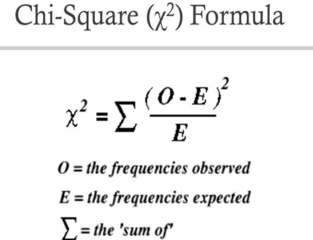
FEATURE SELECTION
CHI-SQUARE METHOD
A chi-square test is used in statistics to test the independence of two events.
Given the data of two variables, we can get observed count O and expected
count E. Chi-Square measures how expected count E and observed count O
deviates each other
SEQUENCE BACKWARD SELECTION
Backward elimination is a feature selection technique while building a machine learning model. It is used to remove those features that do not have a significant effect on prediction the output

Slide 20
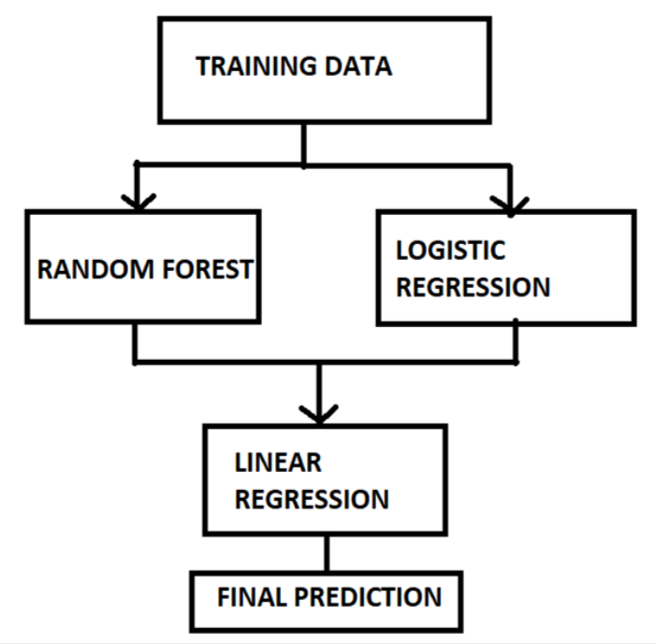
ENSEMBLE MODEL
We are using stacking ensemble learning for our project. Stacking Ensemble learning means using different base learners on same dataset and the output of these base learners are combined by using a meta learner which gives us the final result.

Slide 21
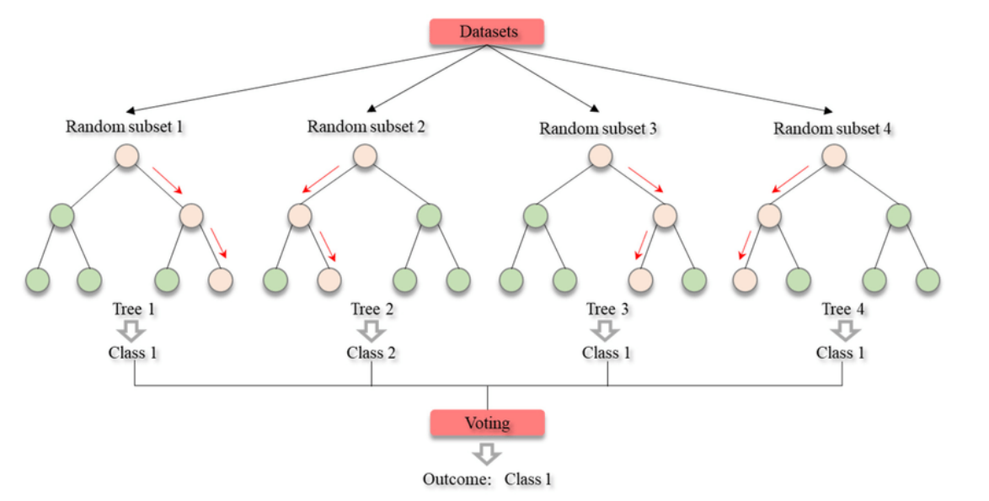
RANDOM FOREST

Slide 22
LOGISTIC REGRESSION
Logistic regression is a supervised learning machine learning technique used for classification problems.
Logistic regression predicts the output of a categorical dependent variable. Therefore the outcome must be a categorical or discrete value. It can be either Yes or No, 0 or 1, true or False, etc. but instead of giving the exact value as 0 and 1, it gives the probabilistic values which lie between 0 and 1
Steps in Logistic Regression: -
Select dependent and independent variables.
Fitting the training set to the model.
Predicting the test result

Slide 23
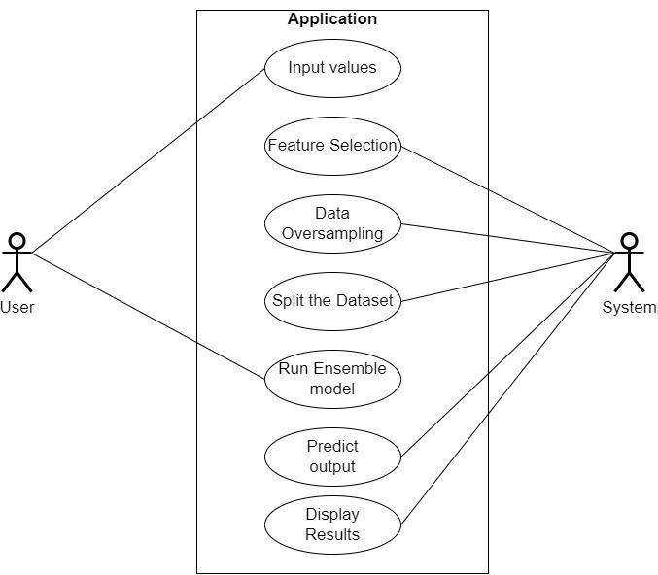
USE CASE DIAGRAM

Slide 24
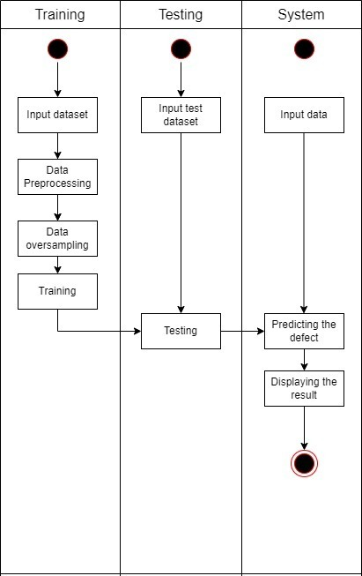
ACTIVITY DIAGRAM

Slide 25
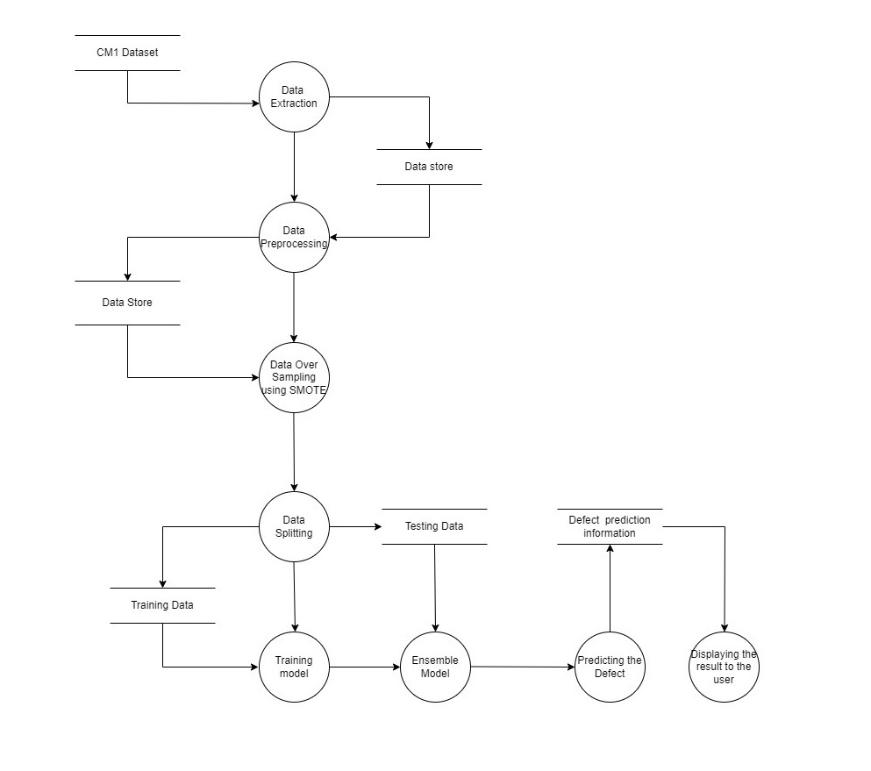
DATA FLOW DIAGRAM

Slide 26
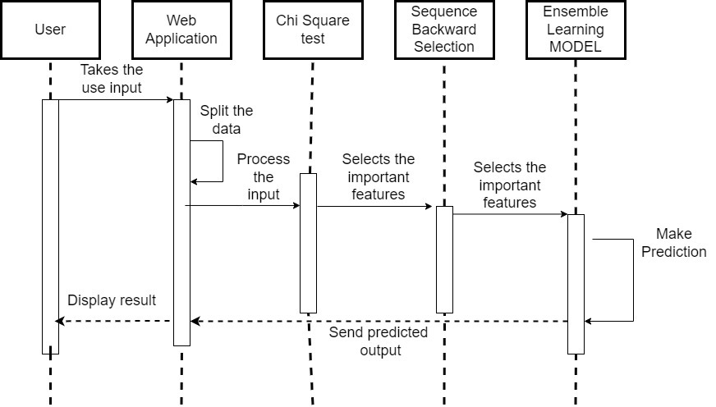
SEQUENCE DIAGRAM

Slide 27
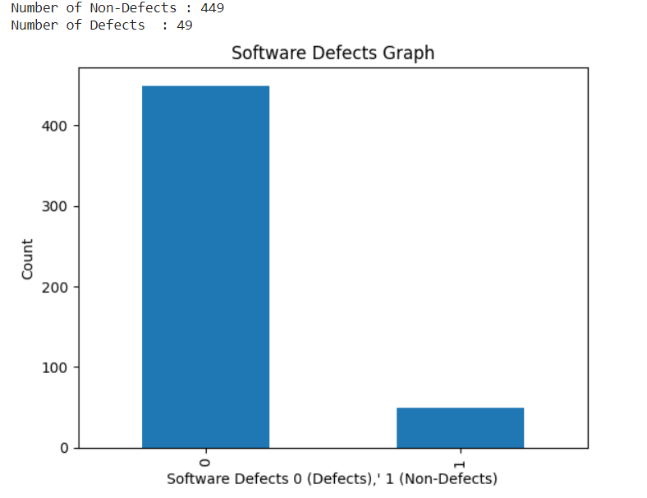
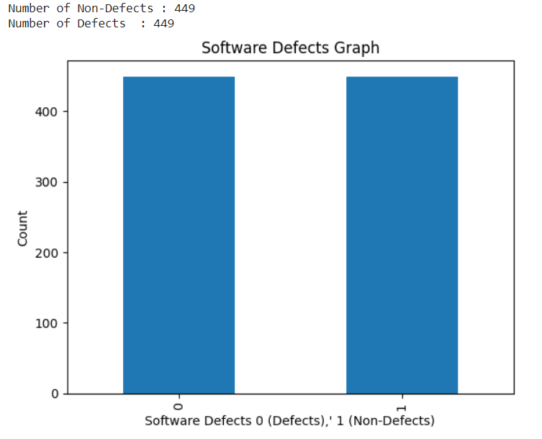
RESULTS AND ANALYSIS
BEFORE SMOTE
AFTER SMOTE

Slide 28
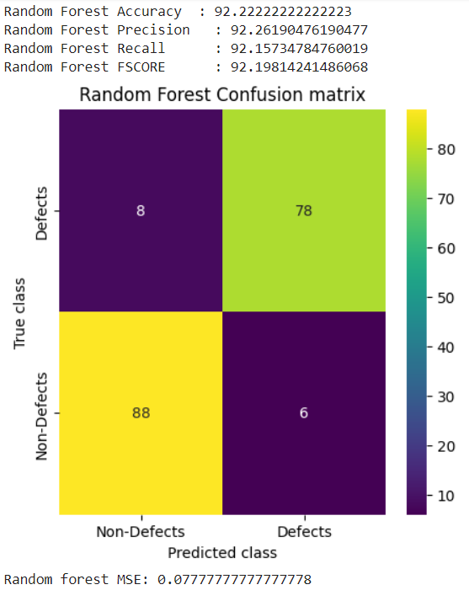
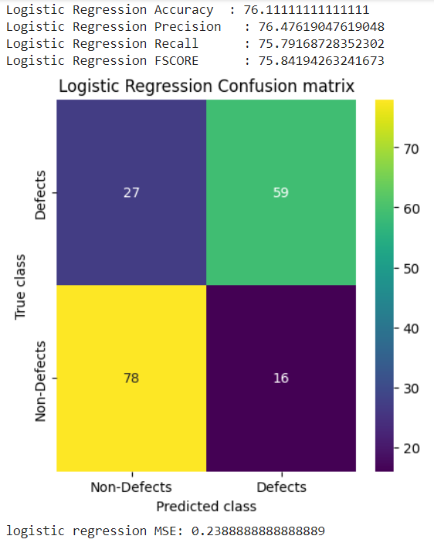

Slide 29
CONCLUSIONS
This project focuses on developing an automated system for code defect detection by analyzing various input metrics, including lines of code, number of comments, and other relevant parameters. Through careful processing of these inputs, the system aims to identify and categorize potential defects within the codebase, providing developers with valuable insights to enhance code quality and streamline the debugging process. The approach leverages advanced algorithms and machine learning techniques to achieve accurate and efficient defect detection, contributing to the improvement of software development practices.
Overall, the goal is to advance the state-of-the-art in software defect prediction by harnessing the power of ensemble learning techniques, ultimately enhancing software quality assurance practices and reducing the incidence of defects in software systems.

Slide 30
FUTURE SCOPE
In future research, further consideration will be given to the combination of different sampling and feature selection methods to improve the performance of the prediction. We also recommend to combine the output of these models with the models that are trained on semantic information of the code. For improved performance, we also advise using real-time data and variety of datasets to train the model.

Slide 31
THANK YOU

